Slide 1
Big Data Based Marketing Analytics. HW 1
Arina Sivkova,
Zaman Farhad,
Nikishin Georgy,
Marina Nemtsova,
Hossain Md Al Amin

Slide 2
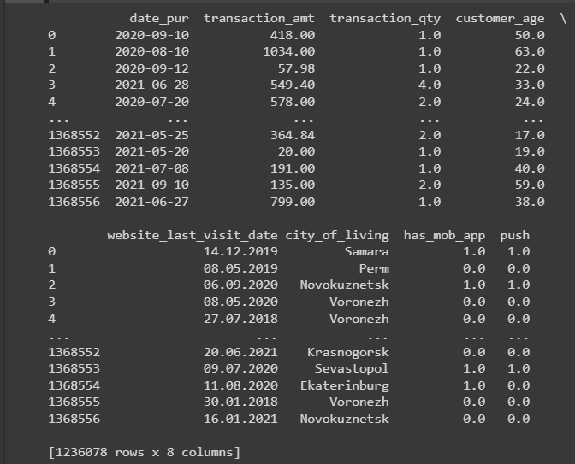
Data Preparation
Removed null data
Deleted incorrect data by age
Dropped outliers by date (like 1970 year)
Deleted negative transactions
Joined the three given tables
Got 1M+ rows
Total 20 columns (only 8 of them are helpful for the analysis

Slide 3
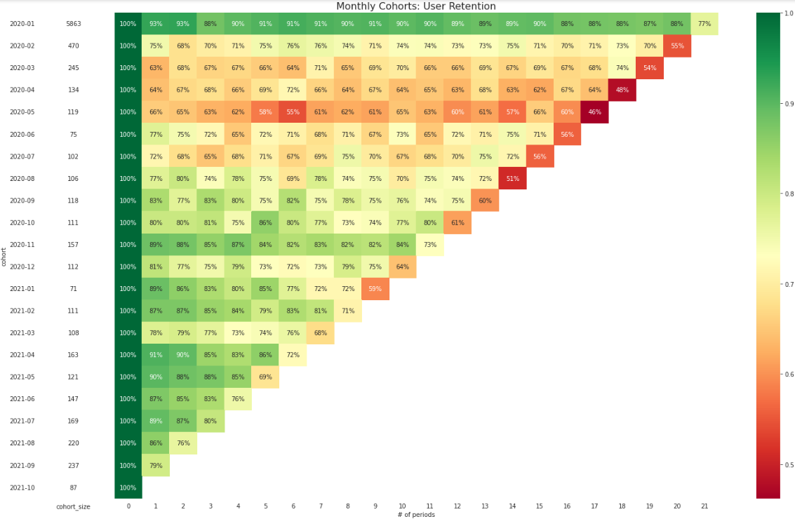
02. Cohort Analysis (split by 21 periods-months of order_date)
Notes:
Cohort was calculated by the monthly transactions
from 2020-01-01 to 2020-12-01 (we dropped 1970)
We clearly see that retention over user lifetime is quite stable. It is avarage 80% of users who still stay retened. ● More noticable is the product retention rate. We see that through time the retention over product lifetime even increases.

Slide 4
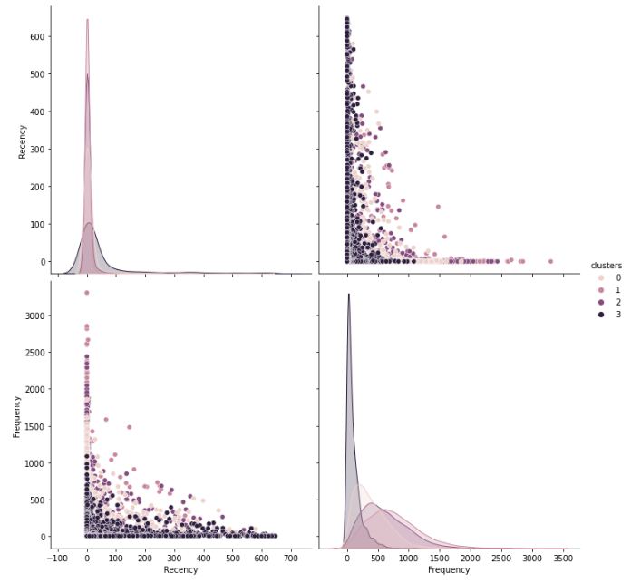
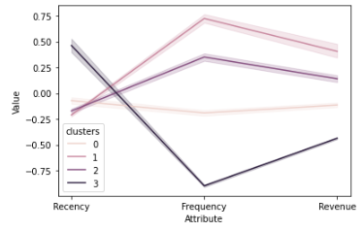
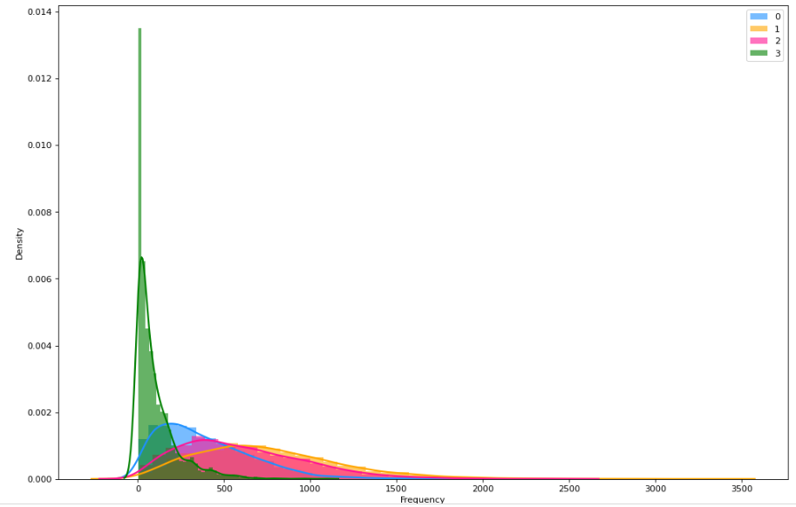
03. Cluster Analysis

Slide 5
04. Cluster description
Cluster 0 (6 029 Customers) Av. age - 45, Av. Revenue - 193 787, Frequency - 256; City of living (Moscow; Krasnodar; Voronezh; Vladivostok; Sevastopol) Biggest merchant: 1. Grocery Stores and Supermarkets 2. Miscellaneous Food Stores-Convenience Stores and Sp Markets 3. Quick Payment Service-Fast Food Restaurants Contacts: Have email - 14%; Have phone - 89%; Have an app - 19%; Have PUSH - 12%
Cluster 1 (2 784 Customers) Av. age - 39, Av. Revenue - 850 868, Frequency - 947; City of living (Moscow; Krasnodar; Vladivostok; Voronezh; Sevastopol) Biggest merchant: 1. Grocery Stores and Supermarkets 2. Miscellaneous Food Stores-Convenience Stores and Sp Markets 3. Quick Payment Service-Fast Food Restaurants Contacts: Have email - 27%; Have phone - 95%; Have an app - 36%; Have PUSH - 24% Cluster 2 (354 Customers) Av. age - 46, Av. Revenue - 54 951, Frequency - 83; City of living (Moscow; Vladivostok; Sevastopol; Novokuznetsk; Krasnodar) Biggest merchant: ; 1. Grocery Stores and Supermarkets 2. Miscellaneous Food Stores-Convenience Stores and Sp Markets 3. Quick Payment Service-Fast Food Restaurants Contacts: Have email - 20%; Have phone - 90%; Have an app - 19%; Have PUSH - 12%
Cluster 3 (24 Customers) Av. age - 42, Av. Revenue - 9 526 715, Frequency – 1 886; City of living (Moscow; Ekaterinburg; Krasnodar; Omsk; Vladivostok) Biggest merchant: 1. Grocery Stores and Supermarkets 2. Quick Payment Service-Fast Food Restaurants 3. Eating Places and Restaurants Contacts: Have email - 42%; Have phone - 92%; Have an app - 50%; Have PUSH - 25%

Slide 6
05. KPI
Cluster 0
- Loyalty growth
- The average check increase
- The frequency of purchases growth - Contacts Base growth
Cluster 1
- The average check increase
- The frequency of purchases maintaining - Contacts Base growth
Cluster 3
- Loyalty growth
- The average check maintaining
- The frequency of purchases maintaining

Slide 7
06. Hypothesis and testing results
Hypothesis | Supported | Not supported
The presence of a mobile app affects frequency of purchases | +
The presence of mobile app affects revenue | +
Having PUSH notifications enabled affects frequency of purchases | +
Having PUSH notifications enabled affects revenue | +
Availability of Email affects frequency of purchases | +
Availability of Email affects frequency revenue | +
Mobile phone affects frequency of purchases |  | -
Mobile phone affects revenue |  | -
Notes:
We used non-parametric test because our data is not normally distributed: Mann-Whitney U test.

Slide 8
07. Marketing strategy (cluster 0)
Instruments | How to do | channels | implementation
App install bonuses | Targeted add
 | SMS (link for app install)
 | Emails
 | E-receipt P.S. message
Push enabling | Auto-consent for new app users
 | In-apps for those who turned them off
Emails base growth | Email's check in-apps
 | E-receipt P.S. message
 | Subscription enabling and Email's check (in-app)
 | Mandatory field for registering new mobile app-users
Cash-back Program | Food, Gas, Pharmacies
Online-payment system | Integration with the most popular retailers for online payment
Subscription package | Popular services discounts

Slide 9
07. Marketing strategy (cluster 1)
Instruments | How to do | channels | implementation
App install bonuses | Targeted add
 | SMS (link for app install)
 | Emails
 | E-receipt P.S. message
Push enabling | Auto-consent for new app users
 | In-apps for those who turned them off
 | Subscription to PUSH topics
Emails base growth | Email's check in-apps
 | E-receipt P.S. message
 | Subscription enabling and Email's check (in-app)
 | Mandatory field for registering new mobile app-users
Cash-back Program | Food, Gas, fast-food restaurants
In-app APPs | Online-stores integration
Online-payment system | Integration with the most popular retailers and fast-food restaurants for online payment

Slide 10
07. Marketing strategy (cluster 3)
Instruments | How to do | channels | implementation
App install | SMS (link for app install)
 | Emails
 | E-receipt P.S. message
Push enabling | Auto-consent for new app users
 | In-apps for those who turned them off
 | Subscription to PUSH topics
Emails base growth | Email's check in-apps
 | E-receipt P.S. message
 | Subscription enabling and Email's check (in-app)
 | Mandatory field for registering new mobile app-users
Special servises | Real estate, Travel, Restaurants
Online-payment system | Integration with the most popular high-end retailers for online payment
Spesial care | Golden cards, closed – club, special events

Slide 11
Thank you!
Any questions?

